Slide 1

Hands-on Intro to developing Explainability for Recommendation Systems

Slide 2
Who am I
Ade Idowu
Lead Data Scientist @ Credit Suisse
Experience: Over 15 years working as a software/ML engineer
Email: adeidowu@hotmail.com
Github: https://github.com/aidowu1
LinkedIn: https://www.linkedin.com/in/ade-idowu-ph-d-854b88/

Slide 3
Agenda
Structure of the workshop
A brief intro to Recommendation Systems (RecSys)
A brief overview of matrix factorization
A brief overview of XAI for RecSys
Exploration of the Movielens data used in this workshop
Model-based RecSys explainers
Post Hoc RecSys explainers
Jupyter notebook demos
Future work
Q & A

Slide 4
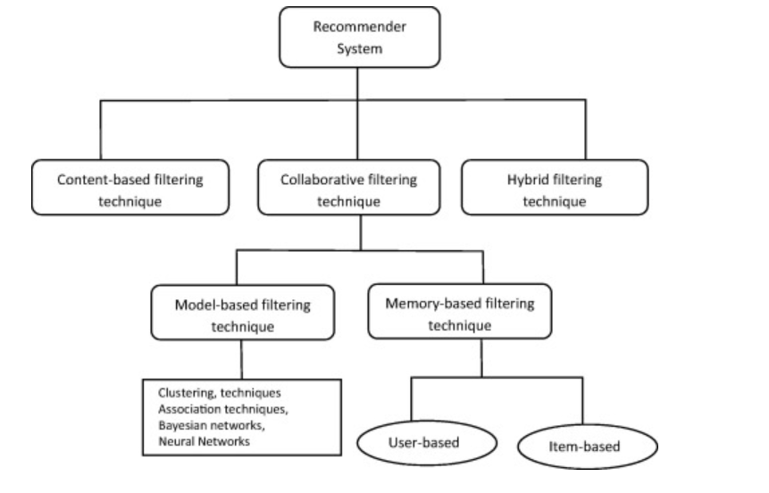
Taxonomy of RecSys
Isinkaye F., Folajimi Y., Ojokoh B. Recommendation systems: Principles, methods and evaluation Egypt. Inform. J., 16 (2015), pp. 261-273, 10.1016/J.EIJ.2015.06.005

Slide 5
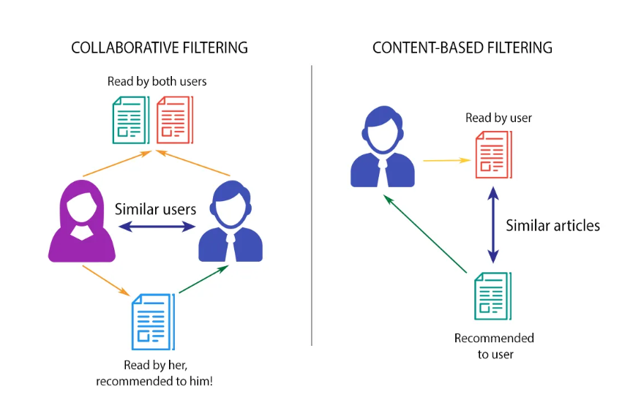
Content-based Vs Collaborative filtering
Sanket Doshi., "Brief on Recommender Systems", Towards Data Science, Feb 10 2019

Slide 6
Types of Recommendations
General recommendations:
Generally, models that utilize user-item interaction only, these include: MF, NeuMF, ItemKNN etc.
Context-aware recommendations:
context-aware recommendation models utilize the features of users, items and user-item interactions, these include: FM, WideDeep, AutoInt etc.
Session-based recommendations:
Session-based recommendation aims at predicting the next item given a sequence of previous items consumed in the session, these include: TransRec, BERT4Rec etc.
Knowledge-based recommendations:
Introduces an external knowledge graph to enhance the recommendation approach, these include: KGAT, KGIN etc.

Slide 7
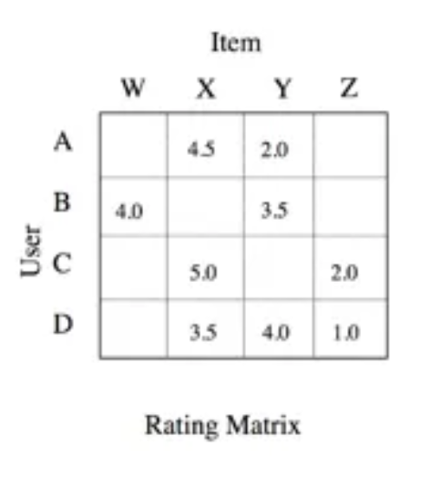
Intro to Matrix Factorization (MF) for RecSys
MF is a model-based approach, generally more accurate than memory-based approah
User-Item interaction (sparse) matrix:
Size: number of users by number of items
Values in the matrix cells are the ratings
Cell values can be continuous (i.e. explicit rating feedback) for instance 1 - 5
Cell values can be discrete (i.e. implicit rating feedback) for instance 0 or 1

Slide 8
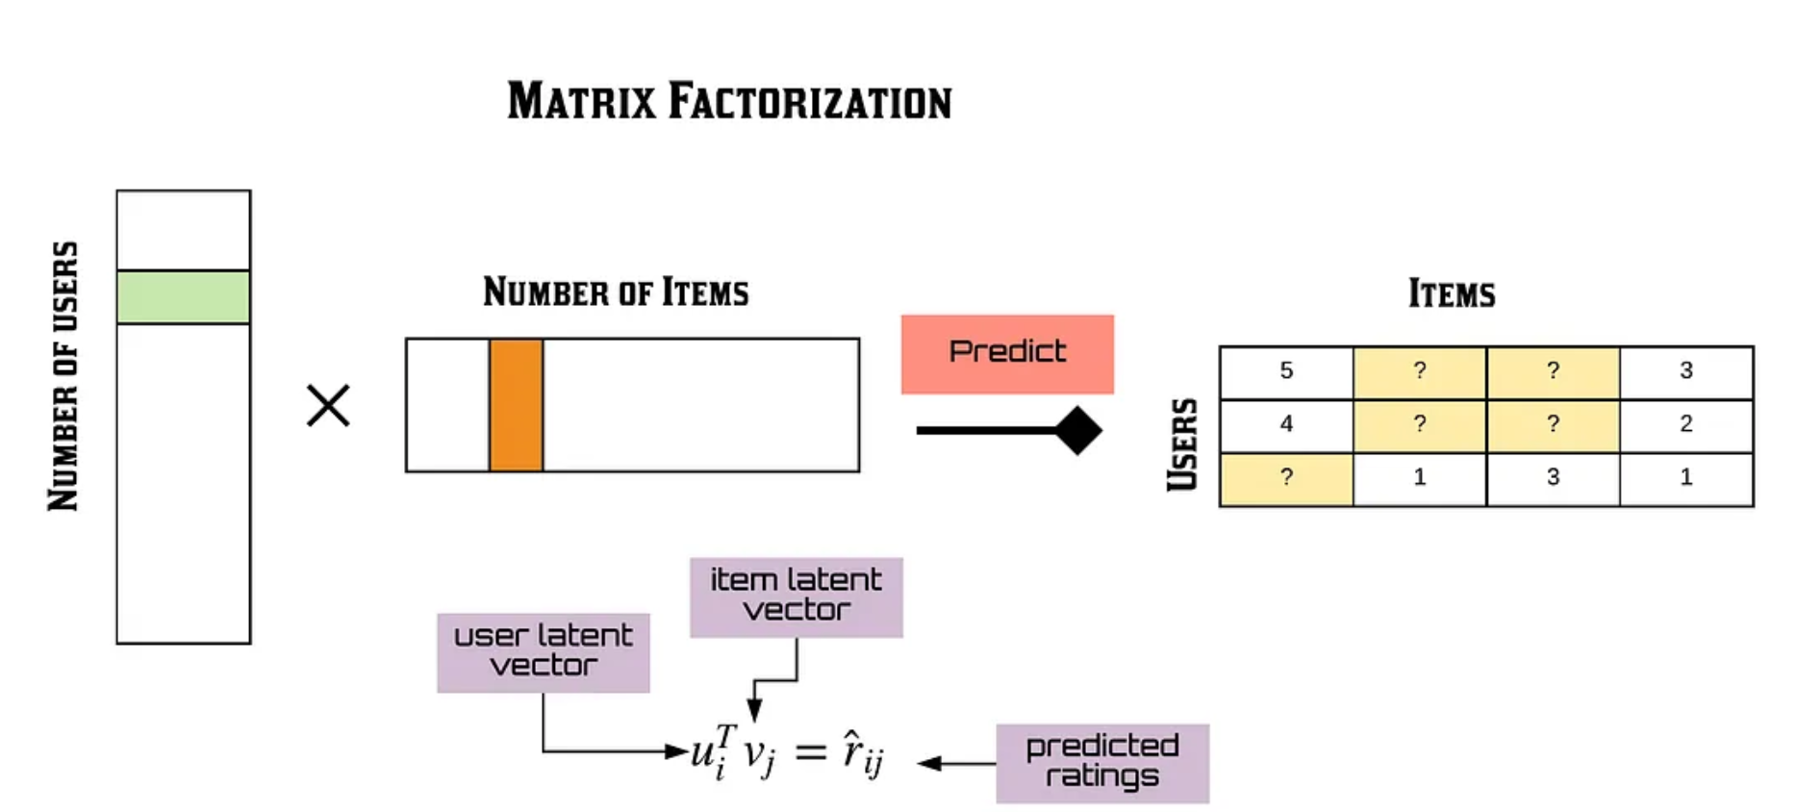
Intro to MF for RecSys (continued)
James Le., "Recommendation System Series Part 4: The 7 Variants of Matrix Factorization For Collaborative Filtering" Towards Data Science, Feb 24 2020

Slide 9
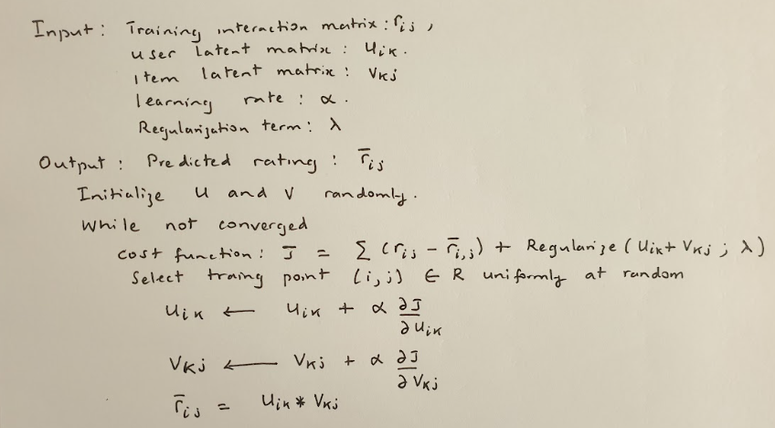
Computing MF with stochastic gradient descent

Slide 10
XAI for RecSys
The rationale for explainable RecSys algorithms is (Yongfeng Zhang and Xu Chen,2020):
to address why – they not only provide users or system designers with recommendation results, but also explanations to clarify why such items are recommended
To facilitate the improvement of the decision system in areas such as:
Transparency
Persuasiveness
Effectiveness
Trustworthiness
User satisfaction of the recommendation systems
Fair and ethical
Yongfeng Zhang and Xu Chen., "Explainable Recommendation: A Survey and New Perspectives" Trends Inf. Retr. 14(1); 1 - 101(2020)

Slide 11
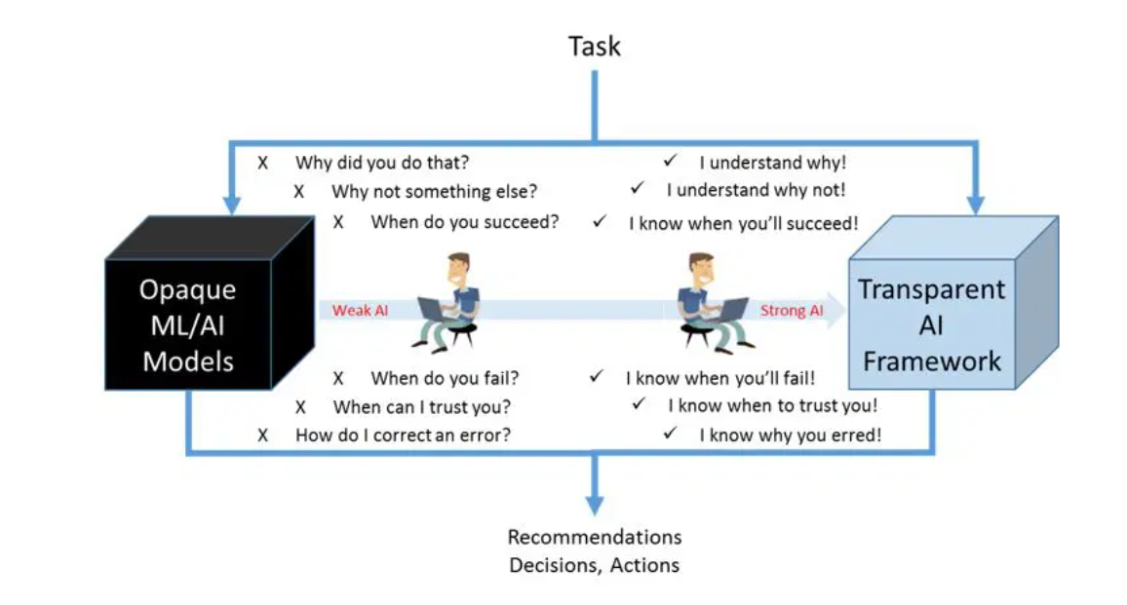
Why should a a RecSys be explainable?
Explainable AI – Transforming AI into Competitive Business Differentiator - Reference: Sogeti Labs

Slide 12
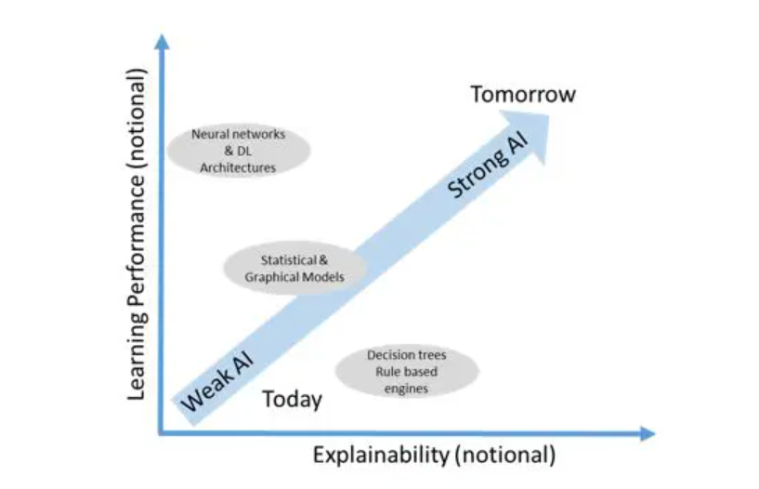
ML Accuracy Vs Explainability Trade-off
Trade-off between model performance and explainability - Reference: Sogeti Labs

Slide 13
Types of Explainability approaches
Model-based (model-intrinsic or ante-hoc) approaches:
develops interpretable models, whose decision mechanism is transparent, and thus, we can naturally provide explanations for the model decisions (Zhang et al 2014)
Post-hoc (model-agnostic) approaches:
allows the decision mechanism to be a blackbox (Peake and Wang, 2018)
it develops an explanation model to generate explanations after a decision has been made
Zhang, Y., G. Lai, M. Zhang, Y. Zhang, Y. Liu, and S. Ma (2014). “Explicit factor models for explainable recommendation based on phrase-level sentiment analysis”. In: Proceedings of the 37th International ACM SIGIR Conference on Research & Development in Information Retrieval. ACM. 83–92.
Peake, G. and J. Wang (2018). “Explanation mining: Post hoc interpretability of latent factor models for recommendation systems”. In: Proceedings of Beyond Personalization 2005: A Workshop on the Next Stage of Recommender Systems Research at the 2005 International Conference on Intelligent User Interfaces, San Diego, CA, USA. ACM. 2060–2069

Slide 14
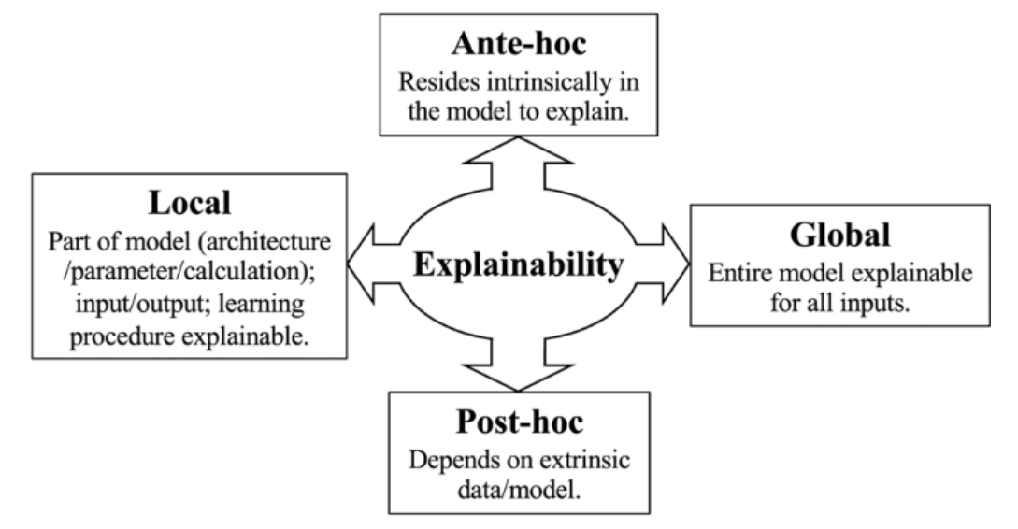
Types of Explainability approaches (continued)
Xiaoting Zhong et al, "Explainable machine learning in materials science" npj Computational Materials 2022, 8 (1)

Slide 15
Types of of RecSys Explanation Styles (Yongfeng Zhang and Xu Chen,2020)
User-style explanations i.e., explanations based on nearest-neighbor users that consume the recommended item
Item-style explanations i.e., explanations based on nearest-neighbor items to the recommended item
Feature-based explanation, i.e., which provides users with the item features that match the target user’s interest profile. This approach is closely related to content-based recommendation methods.
Opinion-based explanation, which aggregates users’ collective opinions in user generated contents as explanations
Textual sentence explanation, which provides the target users with explanation sentences that are constructed user defined template or an NLP generative model
Visual explanations, which provide users with image-based explanations
Social explanations, which provide explanations based on the target user’s social relations

Slide 16
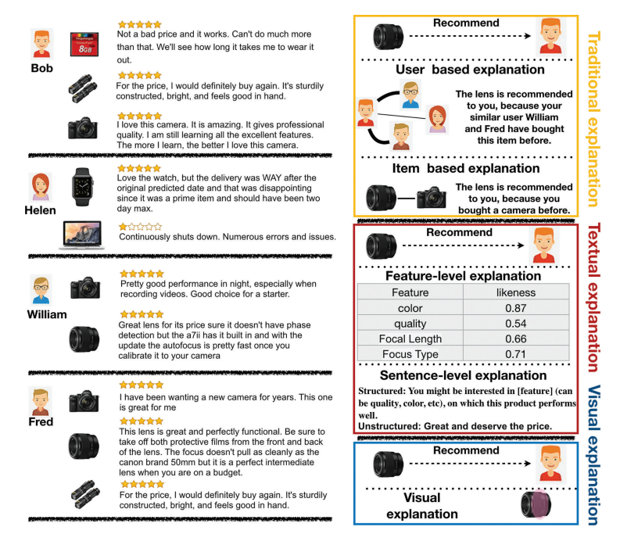
Examples of explanation styles (Yongfeng Zhang and Xu Chen,2020)

Slide 17
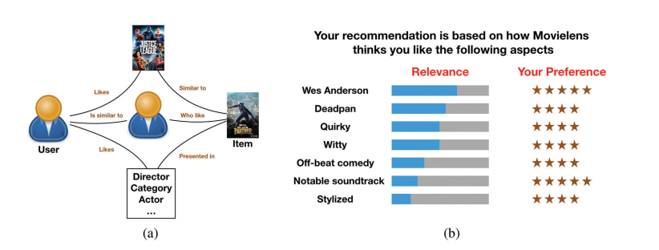
Examples of explanation styles (continued)
Vig, J., S. Sen, and J. Riedl (2009). “Tagsplanations: Explaining recommendations using tags”. In: Proceedings of the 14th International Conference on Intelligent User Interfaces. ACM. 47–56.

Slide 18
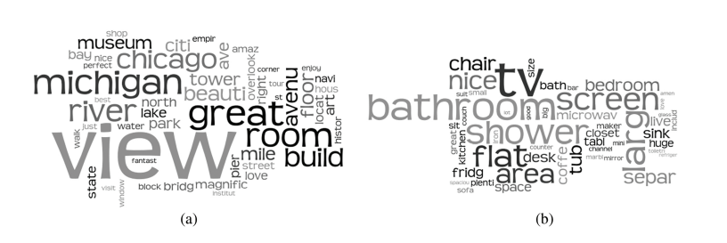
Example sentence style explanation
Wu, Y. and M. Ester (2015). “Flame: A probabilistic model combining aspect based opinion mining and collaborative filtering”. In: Proceedings of the 8th ACM International Conference on Web Search and Data Mining. ACM. 199–20

Slide 19
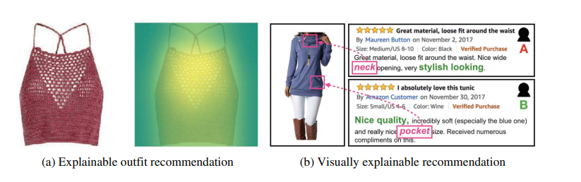
Example of Visual style explanation
Lin, Y., P. Ren, Z. Chen, Z. Ren, J. Ma, and M. de Rijke (2019). “Explainable fashion recommendation with joint outfit matching and comment generation”. IEEE Transactions on Knowledge and Data Engineering. 32(4): 1–16.

Slide 20
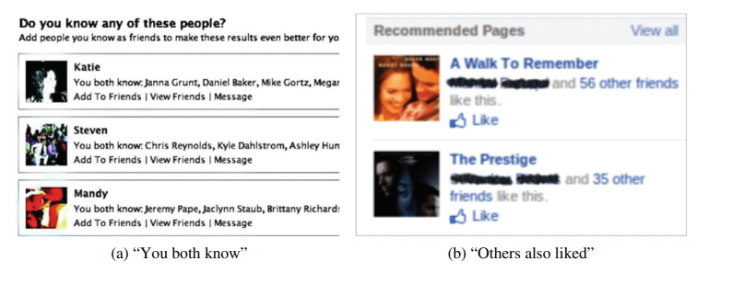
Example social explanation
Sharma, A. and D. Cosley (2013). “Do social explanations work?: Studying and modeling the effects of social explanations in recommender systems”. In: Proceedings of the 22nd International Conference on World Wide Web. ACM. 1133–1144.

Slide 21
Exploration of the Movielens workshop data

Slide 22
Model-based RecSys explainers
Alternating Least Square (ALS) Explanation:
Implemented in RecoXplainer (Ludovik Coba et al)
Explainable Matrix Factorization (EMF) Explanation:
Also implemented in RecoXplainer
Ludovik Coba et al.,"RecoXplainer: A Library for Development and Offline Evaluation of Explainable Recommender Systems" IEEE Computational Intelligence Magazine Feb 2022
https://github.com/ludovikcoba/recoxplainer

Slide 23


ALS Explainer
This is an implicit feedback RecSys model:
purchase history, browsing history, search patterns or mouse clicks
It borrows a lot from the classical ALS approach:
ALS is a scalable way to solve MF
Approach is:
Y. Hu, Y. Koren, and C. Volinsky, “Collaborative filtering for implicit feedback datasets,” in Proc. 8th IEEE Int. Conf. Data Mining, Dec. 2008, pp. 263–272.

Slide 24
Model-based (Ante-hoc) RecSys Explanation
User-Item Interaction Data (optionally can include side-info)
MF
Explainer
Ranking
RecSys

Slide 25



ALS Explainer (continued)
We have a linear model that predicts user preference ȓ _{ui} :
As a linear function of past actions (r_{ui} > 0)
Weighted by item-item similarity S^{u}_{ik}

Slide 26
ALS Explainer Example

Slide 27
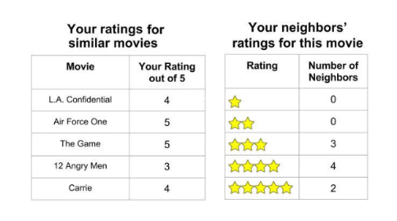
EMF Explainer (B. Abdollahi and O. Nasraoui)
Explanations are based identifying similar users and/or items in the latent space
Presents most similar users and/or items as explanations
Explainability is computed based on rating distribution within the user or item neighborhood

Slide 28


EMF Explainer (continued)
User-based explanation:
Expected value of ratings by similar users that recommended item i as:
Item-based explanation:
Expected value of ratings by similar items to to the recommended item i by the user u as:
B. Abdollahi and O. Nasraoui, “Using explainability for constrained matrix factorization,” in Proc. 11th ACM Conf. Recommender Syst. – RecSys ’17, 2017, pp. 79–83, doi: 10.1145/3109859.3109913

Slide 29

EMF Explainer (continued)
Compute the Explianability matrix between user-item pairs as:
We solve a loss function of the form via SGD:
Explainability term n the objective function J, encourages items, that have higher explainability relative to a user, to be projected close to that user in the latent space, while keeping the rating prediction error small

Slide 30
EMF Explainer Example

Slide 31
Post Hoc RecSys Explanation
User-Item Interaction Data (optionally can include side-info)
Black-box model
Recommendations
Train
Predict
Train
Interpretable surrogate proxy
Explainable recommendations
Predict

Slide 32
Post Hoc RecSys Explainers
Association Rules (AR) Explainer
Based on Association Rules Mining model (surrogate) to explain recommendations computed by the MF black-box RecSys model
Post-hoc kNN Explainer:
Based on using kNN model (surrogate) to identify k-similar items to explain recommendations computed by the MF black-box RecSys model
Factorization Machine (FM) with LIME:
Based on LIME (with Linear model surrogate) to explain recommendations computed by the FM black-box RecSys model

Slide 33
AR Explainer (G. Peake and J. Wang)
AR mining is used to detect rules such as X (antecedent) => Y (consequent) such as beer => diapers
From a set of transactions T = {t₀, t₁, t₂, …t_{n}} over a catalogue of I
Resulting subset is ranked by metrics such as support/confidence/lift
Typically the top D-consequents are kept to explain the recommendations (antecedents)
Python implementation is based on RecoXpaliner (Ludovik Coba et al)
G. Peake and J. Wang, “Explanation mining: Post hoc interpretability of latent factor models for recommendation systems,” in Proc. ACM SIGKDD Int. Conf. Knowledge Discovery Data Mining, Jul. 2018, pp. 2060–2069
Ludovik Coba et al.,"RecoXplainer: A Library for Development and Offline Evaluation of Explainable Recommender Systems" IEEE Computational Intelligence Magazine Feb 2022

Slide 34
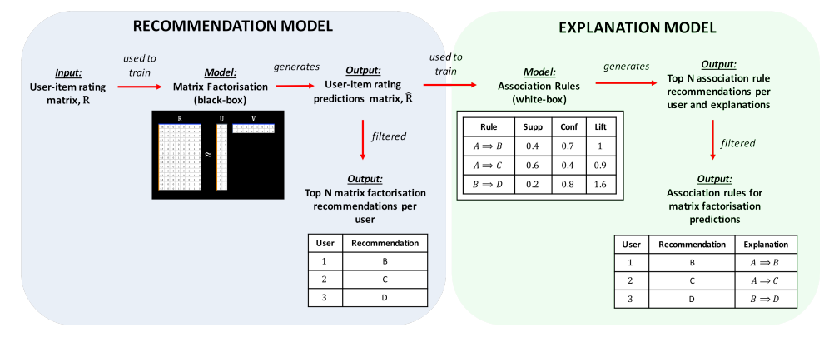
AR Explainer workflow (G. Peake and J. Wang)
G. Peake and J. Wang, “Explanation mining: Post hoc interpretability of latent factor models for recommendation systems,” in Proc. ACM SIGKDD Int. Conf. Knowledge Discovery Data Mining, Jul. 2018, pp. 2060–2069

Slide 35
AR Explainer Example

Slide 36
Post-hoc kNN Explainer (Ludovik Coba et al)
Python implementation is based on the RecoXplianer library
For each user recommendation computed by MF black-box model kNN is used find similar items
Item neighbors are filtered to be in the user training set
Filter only unseen interactions
Use Cosine similarity score to rank items
Draw top D-predictions and their corresponding explanations
Ludovik Coba et al.,"RecoXplainer: A Library for Development and Offline Evaluation of Explainable Recommender Systems" IEEE Computational Intelligence Magazine Feb 2022
https://github.com/ludovikcoba/recoxplainer

Slide 37
kNN Explainer Example

Slide 38
FM - LIME Explainer (Caio Nóbrega and Leandro Marinho)
Compute recommendations using FM black-box rather MF
FM is a context-aware RecSys that accomondates side-info
Use Local Interpretable Model-agnostic Explanations (LIME)
provide a local surrogate (linear model) of the black-box model
Compared to traditional supervised ML models applying LIME to a RecSys models require specification changes/considerations:
Traditional ML have feature vector inputs but RecSys have user, item rating triples
Provide user and/or item features (side-info) that can be used for model explanation
Caio Nóbrega and Leandro Marinho., "Towards Explaining Recommendations Through Local Surrogate Models" Proceedings of the 34th ACM/SIGAPP Symposium on Applied Computing April 2019

Slide 39
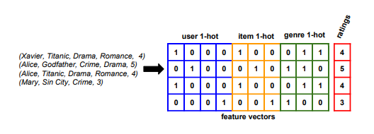
FM - LIME Explainer approach
One-hot encoding of RecSys interaction data (with side-info)
Train the FM recommender on one-hot encoded dataset
Make rating predictions using the trained model
Select a local instance and generate neighborhood samples around it:
By fixing the user and sampling items

Slide 40
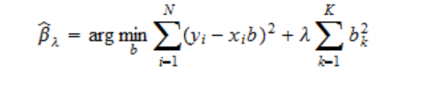
FM - LIME Explainer approach (continued)
Train a Ridge linear regression surrogate model on the neighborhood sample data:
Use trained linear model to compute the weights and the top n relevant features and used to evaluate the explanations graphically

Slide 41
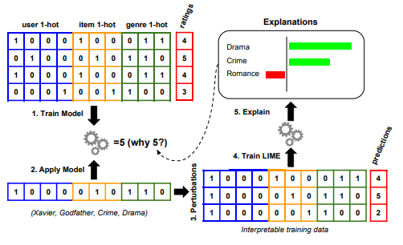
FM - LIME Explainer approach (continued)
Caio Nóbrega and Leandro Marinho., "Towards Explaining Recommendations Through Local Surrogate Models" Proceedings of the 34th ACM/SIGAPP Symposium on Applied Computing April 2019

Slide 42
FM - LIME Explainer Example

Slide 43



Performance Metrics
Matrix factorization metric : Mean Square Error (MSE)
RecSys recommendation metrics
Hit Ratio
Normalized Discounted Cumulative Gain (NDCG)
Explanation Metrics:
Model Fidelity:
Mean Explainable Precision (MEP):
R² (with model fidelity) : for Linear model surrogate via FM-LIME

Slide 44
Future Work
Experiment: generate and compare LIME-RS explanations against AR generated explanations by computing MEP and model fidelity metrics
Extend the LIME local explanations to global explanations, perhaps by introducing SHAP
Explore Knowledge Graph (KG) based explainable RecSys models:
KGs embed rich information about users and items (including side info)
Application of KG can help generate intuitive and more tailored explanations for the recommended items
KG based recommendations are considered to be self-explainable i.e. have intrinsic explainablity (Balloccu Giacomo et al)
Balloccu Giacomo et all "Hands on Explainable Recommender Systems with Knowledge Graphs" In Proceedings of the 16th ACM Conference on Recommender Systems, Sepembetr 2022

Slide 45
Future Work (continued)
Recreate and extend the KG explainable work by Balloccu Giacomo et (https://github.com/explainablerecsys/recsys2022):
Merge interaction dataset and merge with DBpedia KG data
Compute graph embedding using GNN via Pytorch Geometric:
Knowledge Graph Attention Network (KGAT) (Xiang Wang et al)
Use of the RecBole library
Use reinforcement learning Policy Guided Path Reasoning (PGPR) approach to compute the optimal path in the graph and explanation (Yikun Xian et al)
Xiang Wang et al., "KGAT: Knowledge Graph Attention Network for Recommendation" KDD '19, August 2019
Recbole: https://recbole.io/docs/recbole/recbole.model.knowledge_aware_recommender.kgat.html
Yikun Xian et al, "Reinforcement Knowledge Graph Reasoning for Explainable Recommendation" SIGIR ’19, July 2019

Slide 46
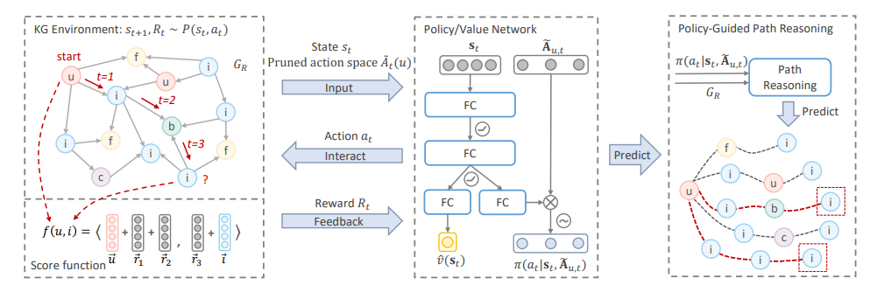
Future Work (continued)

Slide 47
Demos

Slide 48
Q & A

